Slide 1


Amawulire agakwata ku nkola enzenjawulo zoyinza okulondako okuziyiza okukwatibwa akawuka ka mukenenya

Slide 2

Enkola ezenjawulo z’oyinza okulondako okuziyiza okukwatibwa akawuka kamukenenya
Ebintu bingi by’osobola okukola okukendeeza emikisa gy’okufuna akawuka kamukenenya eri gwe oba muganziwo.
Ababudaabuda baagala okukuyamba okutegeera enkola ezenjawulo zino zonna zoyinza okulondako okuziyiza okukwatibwa akawuka kamukenenya osobole okulondako enkola en’esinga okukukolera.

Slide 3
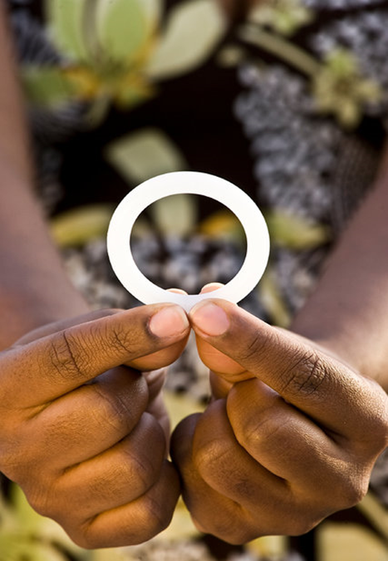
Okunoonyereza kwalaga nti akaweta k’omubukyala aka dapivirine kasobola okukendeeza emikisa gy’okufuna akawuka kamukenenya mu bakyala. Okuziyiza okufuna akawuka kamukenenya kuli waggulu nyo nga akaweta kakozesebwa ekiseera kyona.
Kozesa akaweta k’omubukyala aka dapivirine buli kiseera

Slide 4
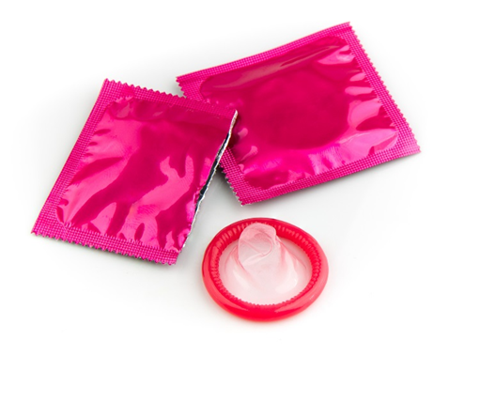
Kozesa obupiira bu Kalimpitawa buli kiseera
Kozesa obupiira bu kalimpitawa mungeri entuufu buli kiseera lwewegattira mubukyala, emabega ewafulumirwa, oba mu kamwa.
Notes:
Laba emabega wakatabo kano ku mawulire amalala agakwatta ku bupiira bukalimpiitawa.

Slide 5
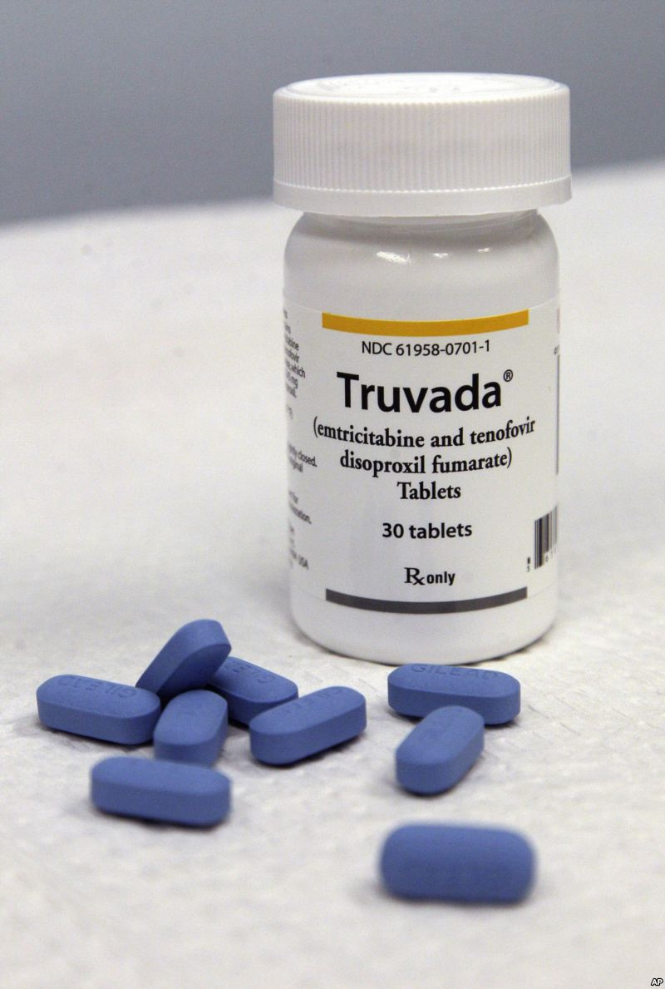
Kozesa amakerenda g’okumira agaziyiza okukwatibwa akawuka kamukenenya (nga truvada)
Amakerenda agamiribwa ag’okukiziyiza nkola yakuziyiza akawuka ka mukenya eri abantu abatalina kawuka kamukenenya naye nga bali mu katyabaga ka maanyi okukwatibwa akawuka kamukenenya.
Amakerenda ag’okumira agaziyiza mulimu okumira ekiika ky’eddagala lya kawuka ka mukenenya buli lunaku.
Amakerenda ag’okumira agaziyiza gayinza okubeerawo oba obutabeerawo mu kitundu gy’obeera.
Notes:
Bw’owulira nti y’enkolai gyewandiyagadde okukozesa,yogera n’omusawo mu kilinika kubikwata kukubeerawo kweddagala linooba mu kitundu kyo mw’obeera.

Slide 6
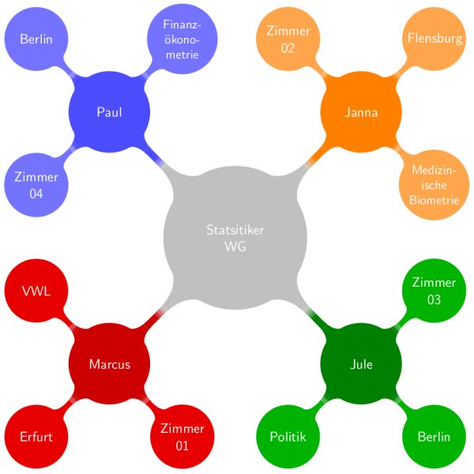
Kendeeza ku muwendo gw’abantu bewegatta nabo?
Notes:
Abantu bewegatta nabo gyebakoma okubeera abangi,,omukisa gwo okubeera n’omuntu gw’ewegatta naye alina akawuka ka mukenenya gweyongera. Muganziwo bw’aba alina abantu bangi beyegatta nabo. mukubiirize okukendeeza kumuwendo guno. Kijja kukendeeza ku mikisa egy’okufuna akawuka kamukenya eri mwena.

Slide 7
Wetabe mu ngeri ez’okwegattamu ezitakuteeka nnyo mubuzibu
Okwegatta ng’okozeza akamwa kikuteeka mu katyabaga katono okusinga okwegattira mu bukyala oba emabega ewafulumirwa.
Abantu bangi balowooza nti okwegattira emabega ewafulumirwa y’engeri ey’okwegatta etarina bulabe, naye mu mazima ye ngeri ey’okwegatta ekyasinga okuba ey’obulabe mu kusiiga akawuka kamukenenya.

Slide 8

Bw’oba n’obulwadde obuyita mu kwegatta (STI), funa obujjanjabi
Bw’oba olina obulwadde obuyita mukwegatta ky’ongera obuzibu bw’okukwatibwa akawuka ka mukenenya oba okukasiiga abalala.
Kakasa nti muganzi wo naye afuna okukeberebwa era n’obujjanjabi.

Slide 9

Kubiriza muganzi wo afune okukeberebwa akawuka kamukenenya
Yogera ne muganzi wo ku by’okukebeza akawuka kamukenenya era mwekebeze nga temunaba kwegatta.
Okumanya oba muganzi wo alina akawuka kamukenenya kisobola okuyamba okusalawo ku ngeri ey’okuziyiza eyinza okusinga okukukolera.

Slide 10
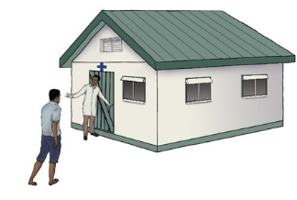
Kubiriza muganzi wo okukomorebwa obusajja
Abaami abakomole balina omukisa ogukendezeddwa ebitundu 50 ku buli kikumi (1/2) ogw’okwattibwa akawuka ka mukenenya nga obagerageranyiza n’abaami abatali bakomole.
Okukomelebwa kwa basajja tekuziyiza bakyala kufuna kawuka kamukenenya.

Slide 11

Muganzi wo bwaba alina akawuka kamukenenya, mukubirize okumira eddagalalye ery’akawuka kamukenenya nga bwatekeddwa okulimira
Notes:
Okujjanjabwa n’ eddagala ly’akawuka kamukenenya (eriyitibwa antiretroviral therapy oba ART mubufunze) kiyamba abantu abalina akawuka kamukenenya okuwangala ebbanga egwanvu n’obulamu obulungi. Eddagala lya kawuka ka mukenya terisobola kukawonya, naye lisobola okukendeeza kubungi bw’akawuka mu mubiri.Okubeera n’obuwuka bwa mukenenya obutono mu mubiri kikendeeza kubuzibu bwa muganzi wo okukusiiga akawuka nga mwegatta.

Slide 12
Newankubadde engeri zoona ziyinza obutasoboka eri abakyala bonna, bw’okola ebingi kubintu bino oyongera okukendeza emikisa gy’okufuna akawuka ka mukenenya.
Muganzi wo bwaba alina akawuka kamukenenya, mukubirize okumira eddagalalye ery’akawuka kamukenenya nga bwatekeddwa okulimira

Slide 13

Obubaka obulala obukwata ku bupiira bu kalimpitawa
Obupiira bukalimpiitawa bukukuuma okukwatibwa akawuka ka mukenenya nga wegattira mu bukyala oba emabega ewafulumirwa.
Akaweta aka dapivrine kakendeeza omukisa gw’okwatibwa akawuka ka mukenenya nga kayita mukwegattira mu bukyala.
Akaweta tekaakolebwa kuziyiza kusiiga kawuka ka mukenenya nga mwegattira emabega ewafulumirwa era tekalina kukozesebwa emabega mukyenda ekifulumya obubi (rectum).

Slide 14
Obubaka obulala obukwata ku bupiira bu kalimpitawa
Obupiira bu kalimpitawa buziyiza okufuna olubuto ne ndwadde endala eziyitira mukwegatta.
Notes:
Okwongereza ku kukuuma okwattibwa akawuka kamukenenya, obupiira bukalimpiitawa bulina emiganyulo emirala eri embeera y’obulamu bwo. Abagalana abamu balondako obupiira bukalimpiitawa nga enkola yabwe ey’ekizaala gumba ey’okwegema okufuna embuto zebatetegekede.

Slide 15
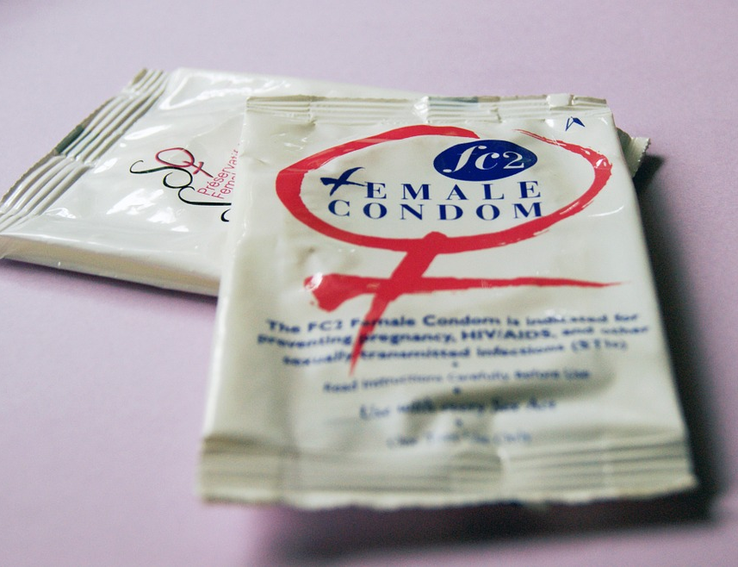

Obubaka obulala obukwata ku bupiira bu kalimpitawa
Bwebukozesebwa buli kiseera era mubutufu Obupiira bukalimpitawa ye ngeri esinga okuziyiza endwadde eziyitira mu kwegatta nga Enziku, nkumunye nokubundula amazzi agawunya.
Notes:
Ate era obupiira bukalimpitawa bukendeeza ku mikisa ’gy’okwatibbwaendwadde ezileeta amabwa mu bitundu eby’ekyaama, okubundula amazzi agawunya, n’enkumunye ekitundu ekwattiddwa obulwadde oba ekitundu obulwadde mwebuyinza okuyita kibikiddwa. Zisobola okukendeeza ku mikisa gy’okwattibwa obulwadde obuletebwa akawuka akaleeta kookolo(HPV) n’endwadde endala ezekuusa ku HPV(nga ensundo ezikwata mu bitundu byekyaama era ne kokolo ow’okumumwa gwa’nabaana)

Slide 16
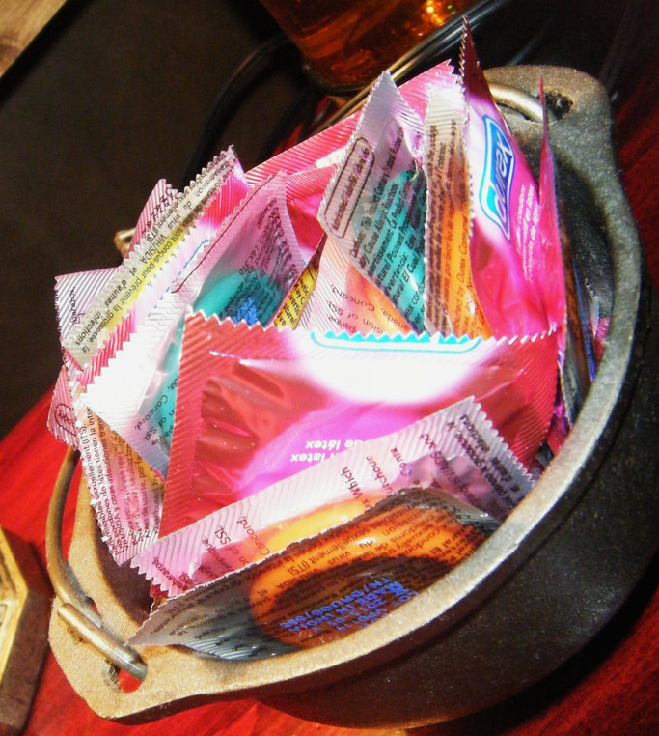
Okukozesa abupiira bu kalimpitawa mu butuufu era buli kiseera:
Kozesa akapiira ka kalimpitatwa akapya mu buli kikolwa eky’okwegatta (mukamwa, mu bukyala era n’emabega ewafulumirwa)

Slide 17
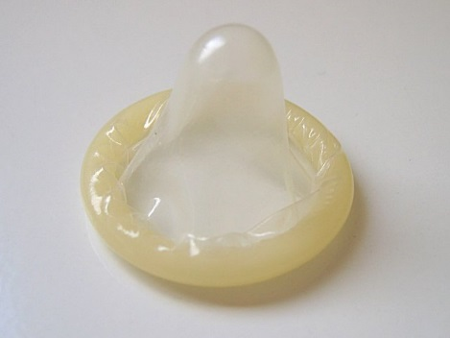
Okukozesa abupiira bu kalimpitawa mu butuufu era buli kiseera:
Akapiira kakalimpitawa kakwate n’obwegendereza okwewala okukafumita n’enjala z’okungalo, amannyo oba ebintu ebirala ebisala.
Teekako akapiira kakalimpitawa ng’ obusajja buyimiridde era nga tonaba kwegattira mubukyala,mukamwa ,oba emabega ewafulumirwa ne muganzi wo.

Slide 18
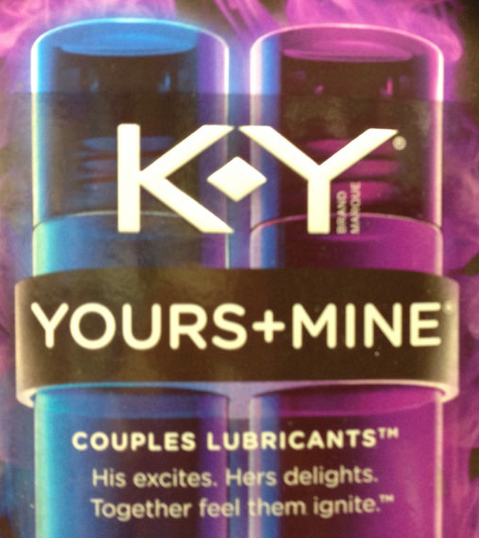
Okukozesa abupiira bu kalimpitawa mu butuufu era buli kiseera:
Kakasa nti waliyo obuseerezi obumala nga wegattira mu bukyala oba emabega ewafulumirwa naye kozesa ebyo ebilimu amazzi (nga K-Y Jelly) ng’okozesa obupiira bu kalimpiitawa.
Ebiseereza ebilimu oilo nga (ebizigo oba lotion ey’okumubiri) bigya kwonona akapiira ka kalimpitawa.

Slide 19
Okukozesa abupiira bu kalimpitawa mu butuufu era buli kiseera:
Okuziyiza akapiira obutaseerera, kwata akapiira kakalimpitawa okanywereze obusajja gyebutandikira (base) ng’obusajja buvaamu, era obusajja buveemu nga bukyayimiridde.

Slide 20

Bw’oba olina ebibuuzo oba wetaaga okumanya ebisingawo, Nkusaba okyalire kilinika yo kunoonyereza.

